Slide 1
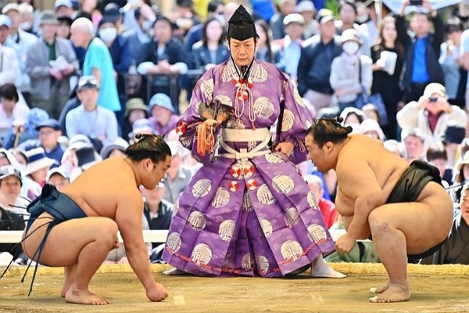

Slide 2
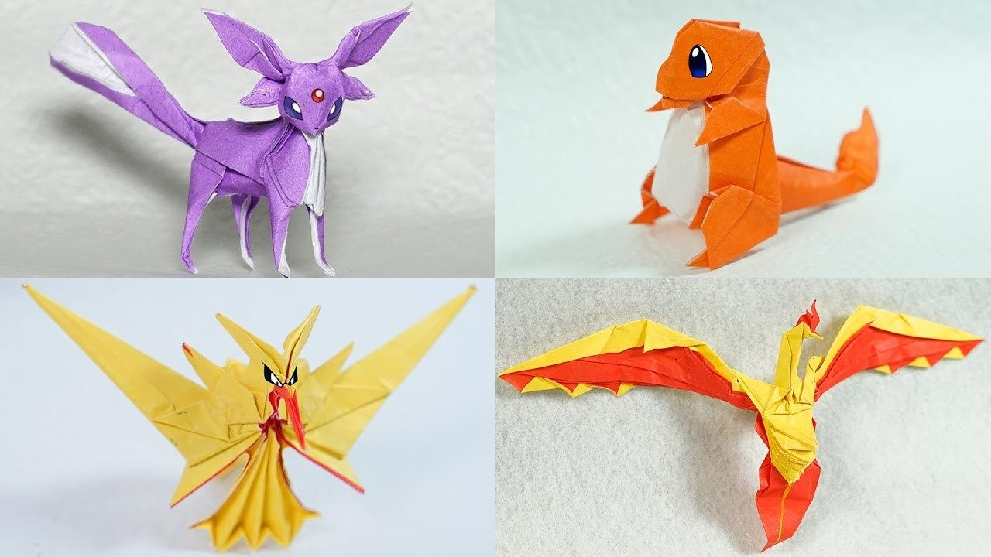
Origami is an ancient Japanese paper folding technique. In fact, origami was a Chinese invention, but the Japanese made it an art form.

Slide 3
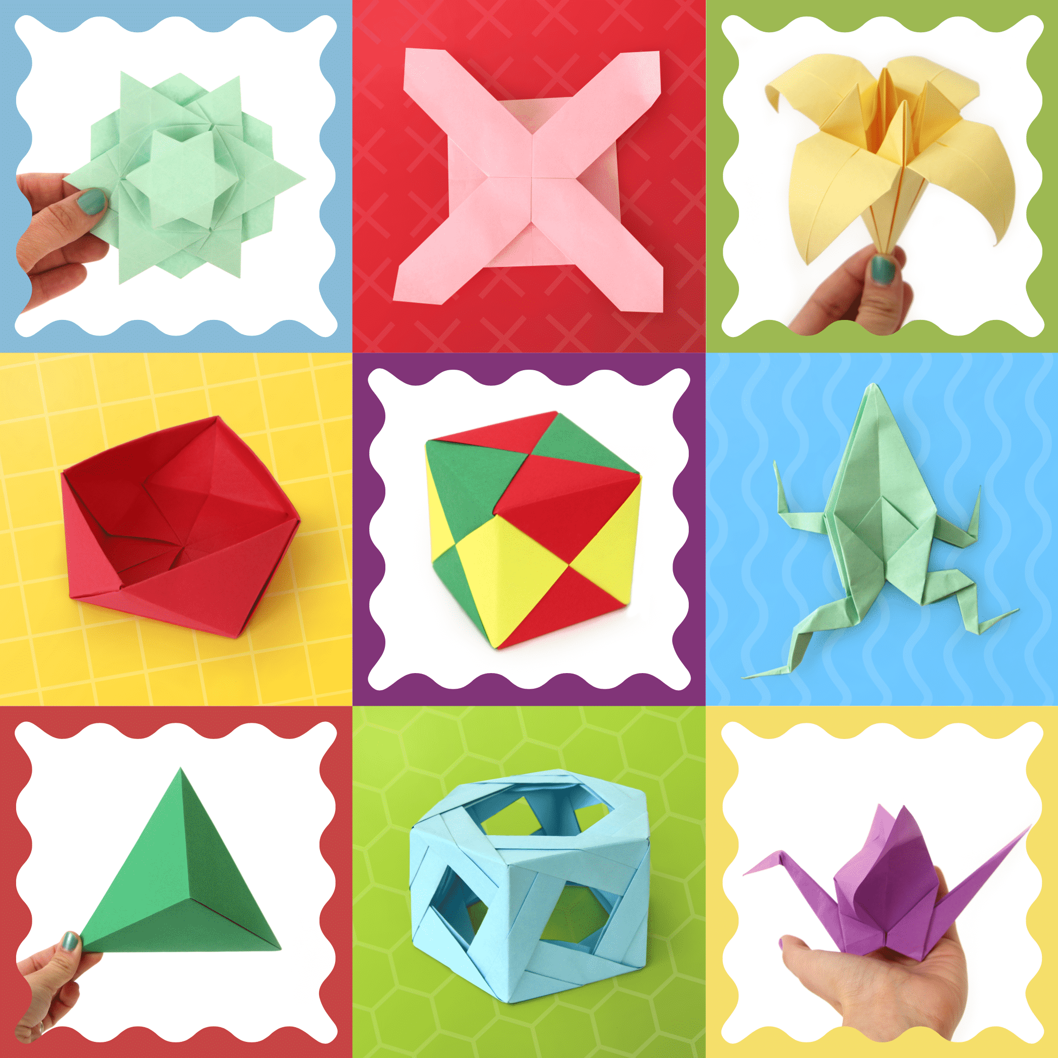
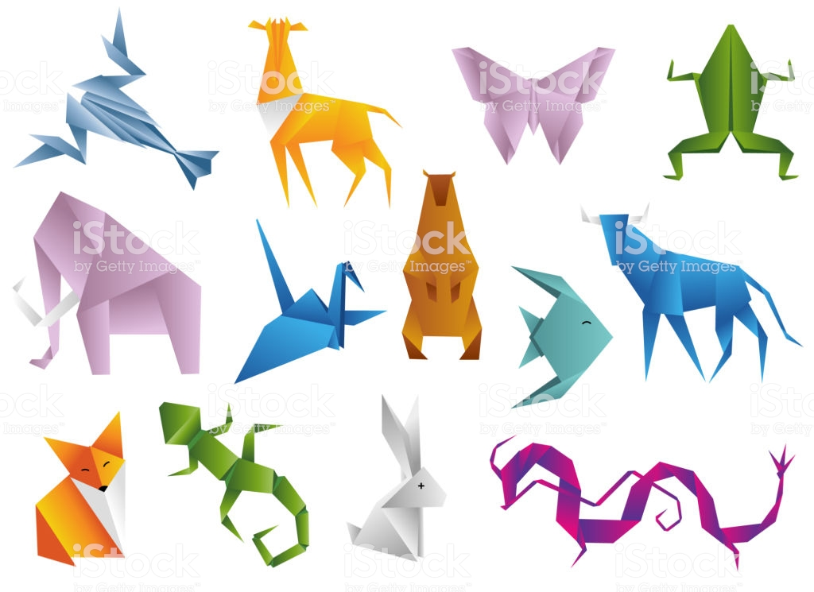
In Japanese, origami means fold “oru” paper “kami.” Some things are very easy to make, and some things can be very, very complex! Here are some instructions to make a frog!

Slide 4
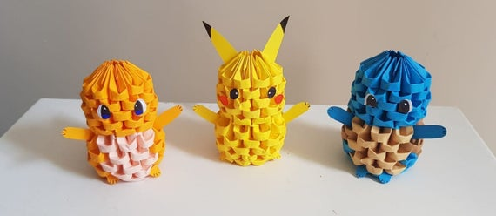
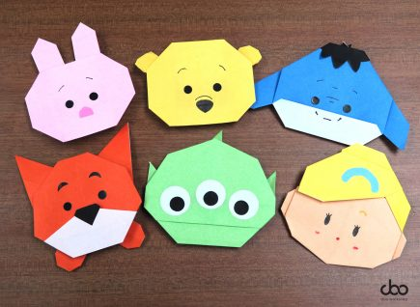
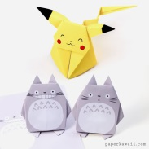
Step 1 Start with a square piece of paper.
Then fold the paper into four squares
and open the paper again.
Step 2 Fold each of the four corners to the
center point.

Slide 5
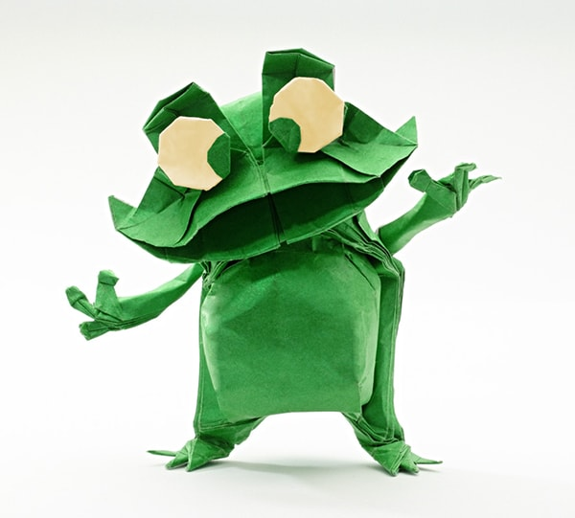
Step 3 Fold each of the two sides in to the
center line.
Step 4 Fold the triangle at the bottom up.

Slide 6
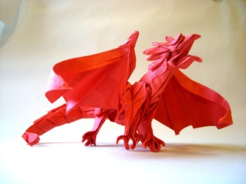
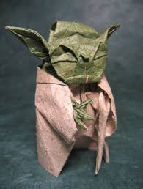
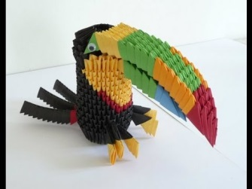
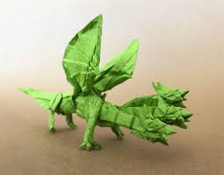
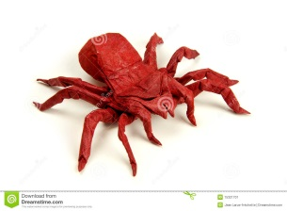
Step 5 Fold each of the bottom two corners
into the center.
Step 6 Fold the bottom part up (along the
dotted line).

Slide 7
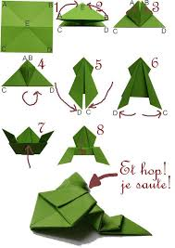
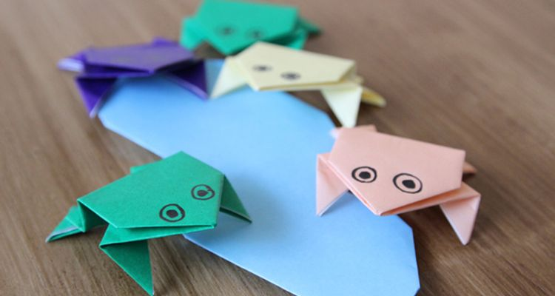
Step 7 Fold the top half of the lower rectangle
down to make the frog’s legs.
Step 8 Make your frog’s head: fold the end of
the point down and draw two eyes.
Your frog is done.

Slide 8
